Slide 1
Preliminary calcium imaging analyses on spatial reversal task
Lab meeting
February 1, 2021

Slide 2
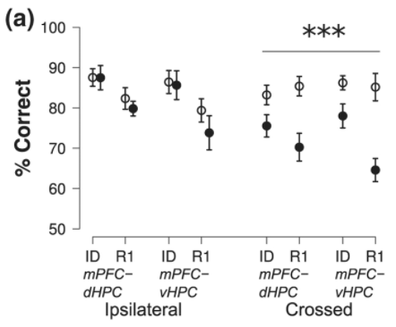

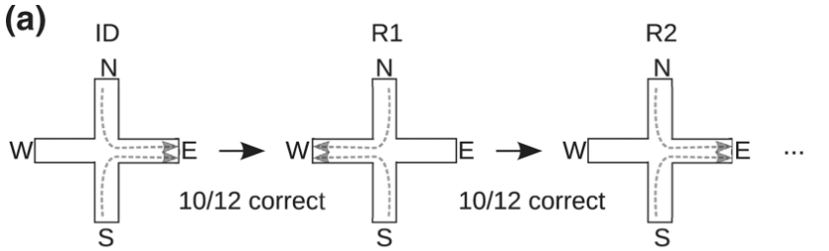
dCA1 and vCA1 projections to frontal cortex are necessary for spatial reversal
Avigan et al., 2020

Slide 3
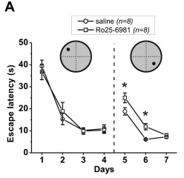
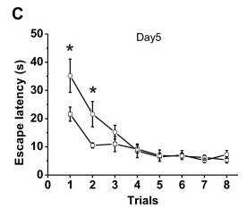
LTD inhibition in CA1 impairs spatial reversal
Elevated platform stress induces LTD and accelerates reversal learning
LTD inhibition impairs reversal learning
Dong et al., 2013

Slide 4
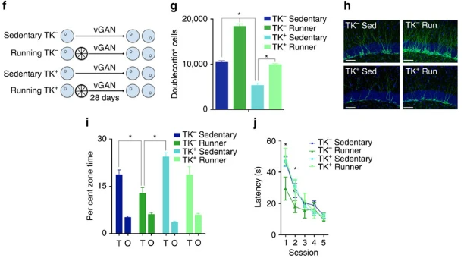
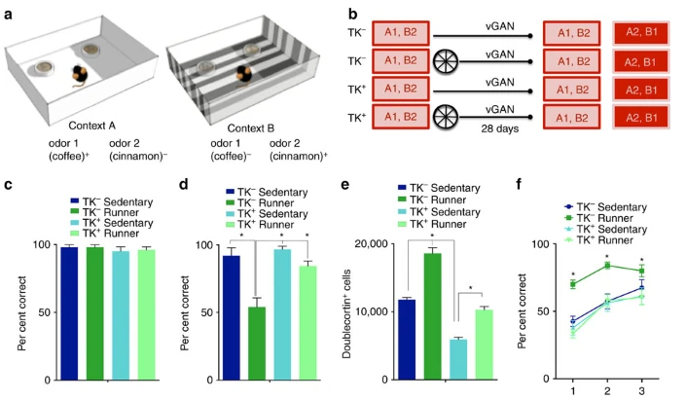
Neurogenesis is important for spatial reversal
Most neurogenesis
Most neurogenesis
Epp al., 2016

Slide 5
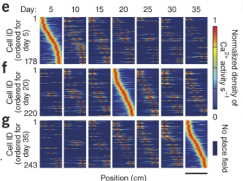
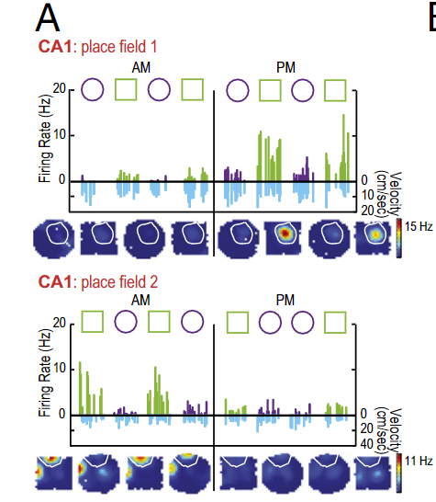
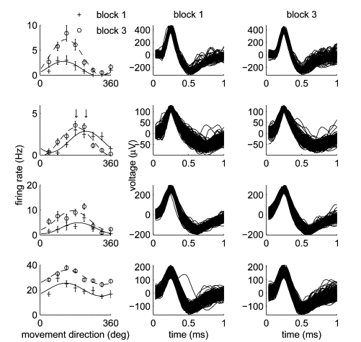
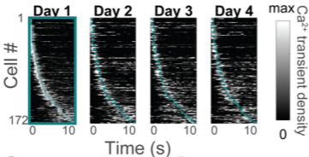
Neural correlates of memory are not completely stable – “drift”
Mankin et al., 2012; 2015
(rat CA1 and CA2, tetrodes)
Ziv et al., 2013; Mau et al., 2018 (mouse CA1, miniscopes)
Rokni et al., 2007 (monkey SMA and M1, monotrodes)

Slide 6
Big questions and proposed experiments

Slide 7
Big questions and proposed experiments
Is dCA1 required for spatial reversal on my task?
dCA1 PSAM inhibition.
Injections Feb/March 2021

Slide 8
Big questions and proposed experiments
Is dCA1 required for spatial reversal on my task?
dCA1 PSAM inhibition.
Is neural stability/persistence related to perseveration?
Quantify “persistence” and correlate to reversal performance.
Injections Feb/March 2021
In progress

Slide 9
Hypothesis: Drift reflects (homeostatic?) plasticity that endows flexibility on neural networks
Reversal performance
“Persistence”

Slide 10
Big questions and proposed experiments
Is dCA1 required for spatial reversal on my task?
dCA1 PSAM inhibition.
Is neural stability/persistence related to perseveration?
Quantify “persistence” and correlate to reversal performance.
Does reducing persistence rescue perseveration?
Inhibit LTD or neurogenesis while recording CA1 and measuring reversal performance.
Injections Feb/March 2021
In progress
Early summer 2021?

Slide 11
Hypothesis: Drift reflects (homeostatic?) plasticity that endows flexibility on neural networks
Reversal performance
Reversal performance
“Persistence”
“Persistence”
Control
Inhibiting LTD or neurogenesis
Control
Inhibiting LTD or neurogenesis

Slide 12
Big questions and proposed experiments
Is dCA1 required for spatial reversal on my task?
dCA1 PSAM inhibition.
Is neural stability/persistence related to perseveration?
Quantify “persistence” and correlate to reversal performance.
Does increasing persistence induce perseveration?
Inhibit LTD or neurogenesis while recording CA1 and measuring reversal performance.
Do aged mice fail at spatial reversal and can it be explained by neural predictors?
Test if old CA1 maps are reactivated, but fail to be updated during reversal.
Injections Feb/March 2021
In progress
Early summer 2021?
First aged mouse starts recording in 2 weeks

Slide 13
Hypothesis: CA1 activation patterns in aged mice are inflexible
Reversal performance
“Persistence”
Young adult
Aged
Young adult
Aged

Slide 14
Big questions and proposed experiments
Is dCA1 required for spatial reversal on my task?
dCA1 PSAM inhibition.
Is neural stability/persistence related to perseveration?
Quantify “persistence” and correlate to reversal performance.
Does increasing persistence induce perseveration?
Inhibit LTD or neurogenesis while recording CA1 and measuring reversal performance.
Do aged mice fail at spatial reversal and can it be explained by neural predictors?
Test if old CA1 maps are reactivated, but fail to be updated during reversal.

Slide 15
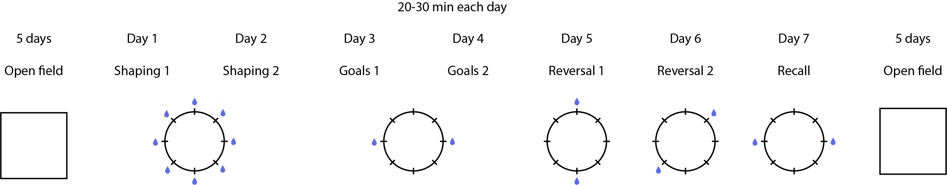
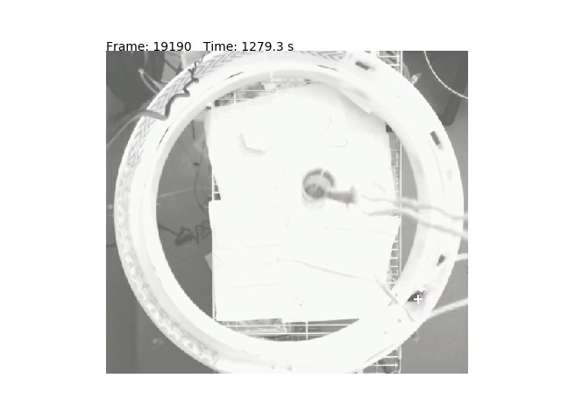
n = 5 wild-type adult mice
(+6 behavior-only mice):
Castor
Encedalus
Hydra
Fornax
Io
V3
Poor behavior due to tech difficulties
V4

Slide 16
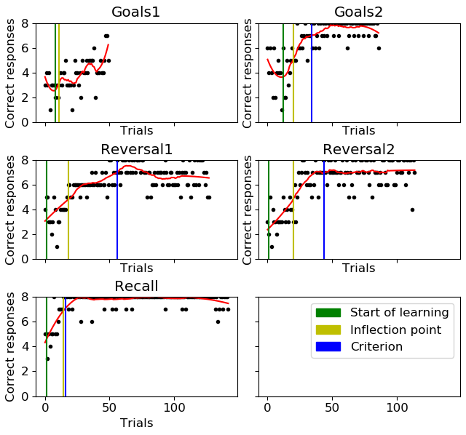
“Trials to criterion” for measuring reversal performance
Criterion arbitrarily defined as 5+ consecutive trials where smoothed correct responses ≥ 7

Slide 17
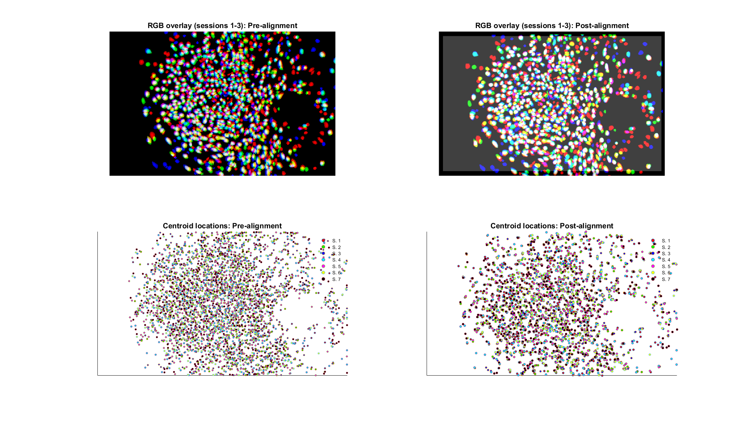
Castor, V3

Slide 18
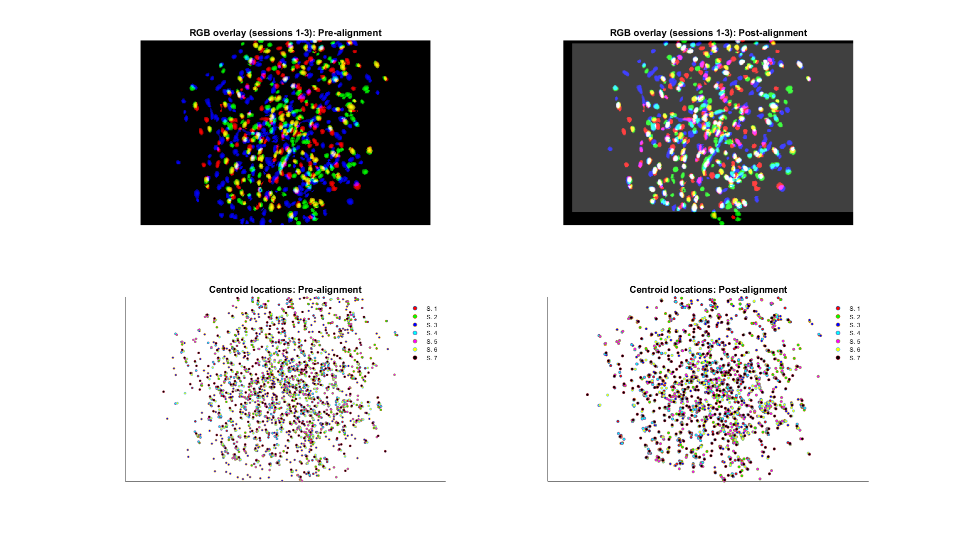
Encedalus, V3

Slide 19
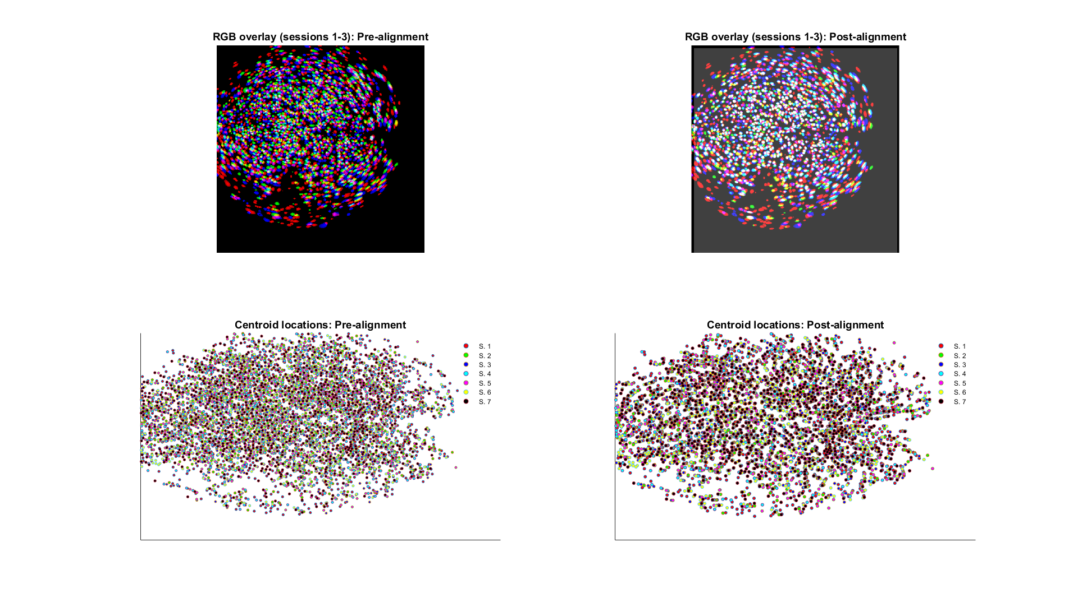
Fornax, V4

Slide 20
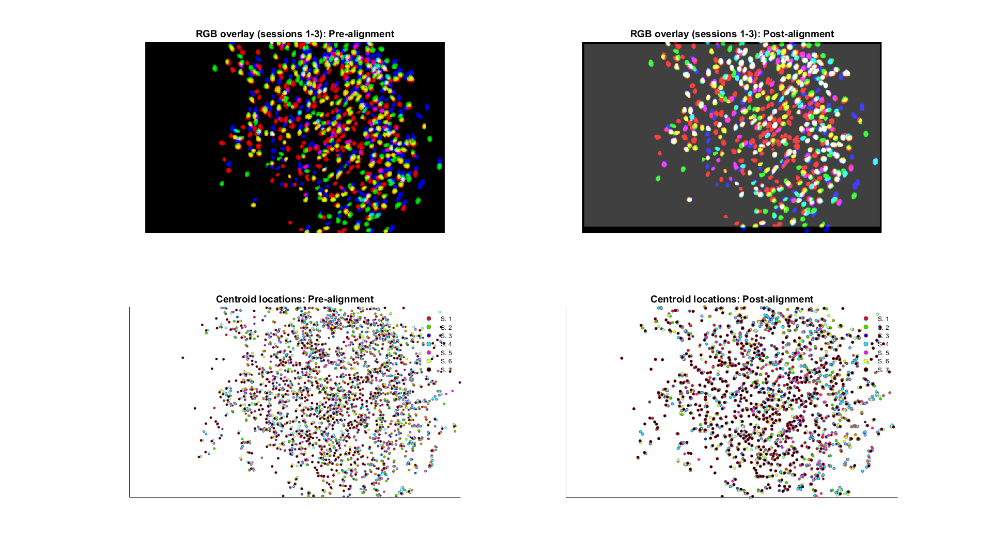
Hydra, V3

Slide 21
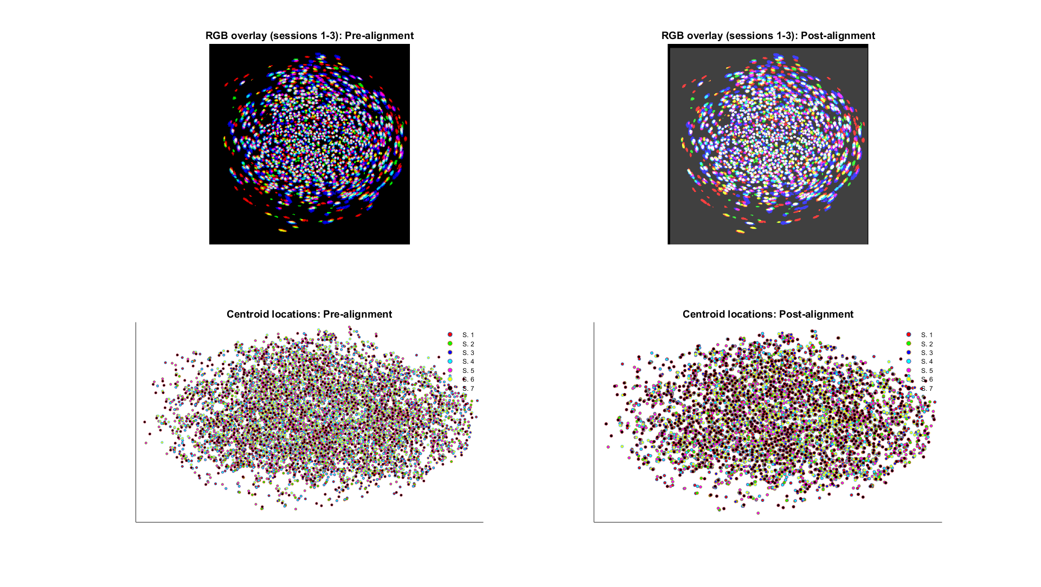
Io, V4

Slide 22
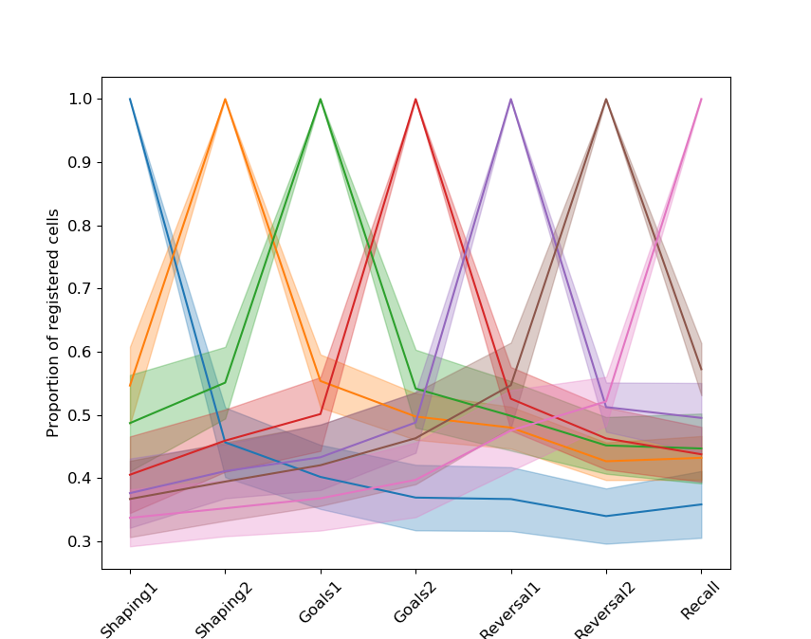
Cell registration overlaps

Slide 23
How to measure “persistence”?
Firing field correlations
Ensemble reactivations

Slide 24
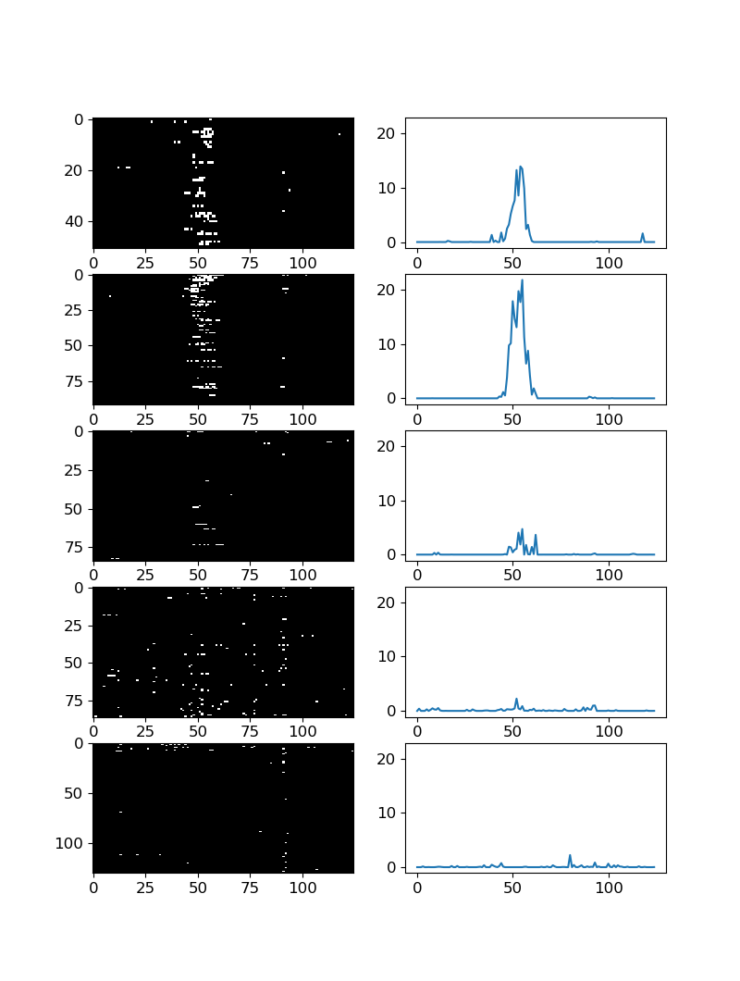
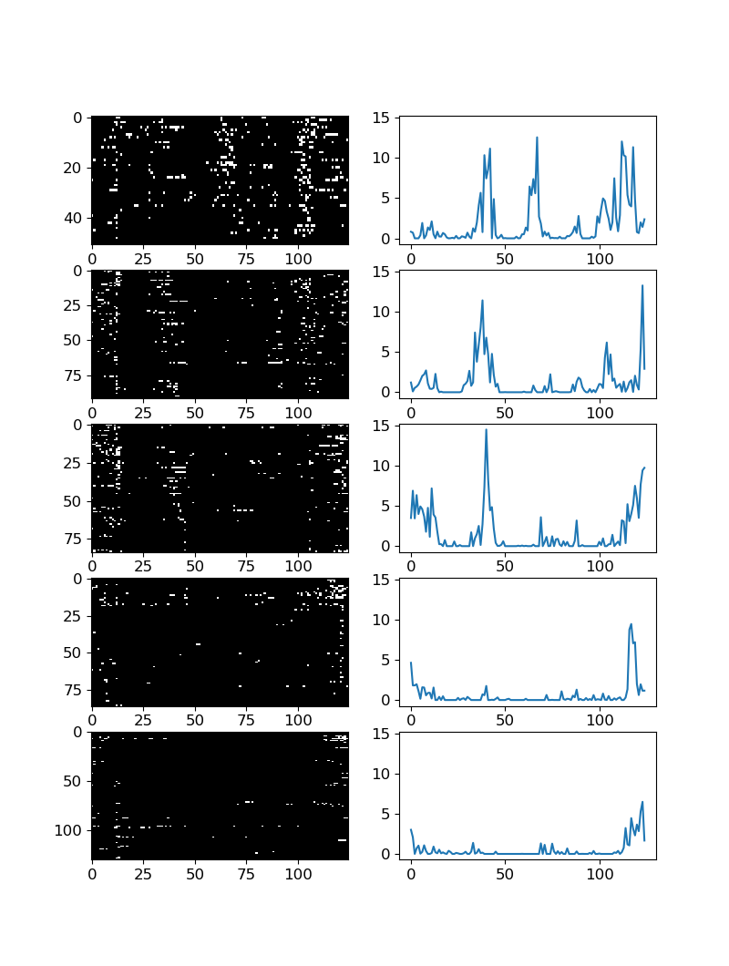
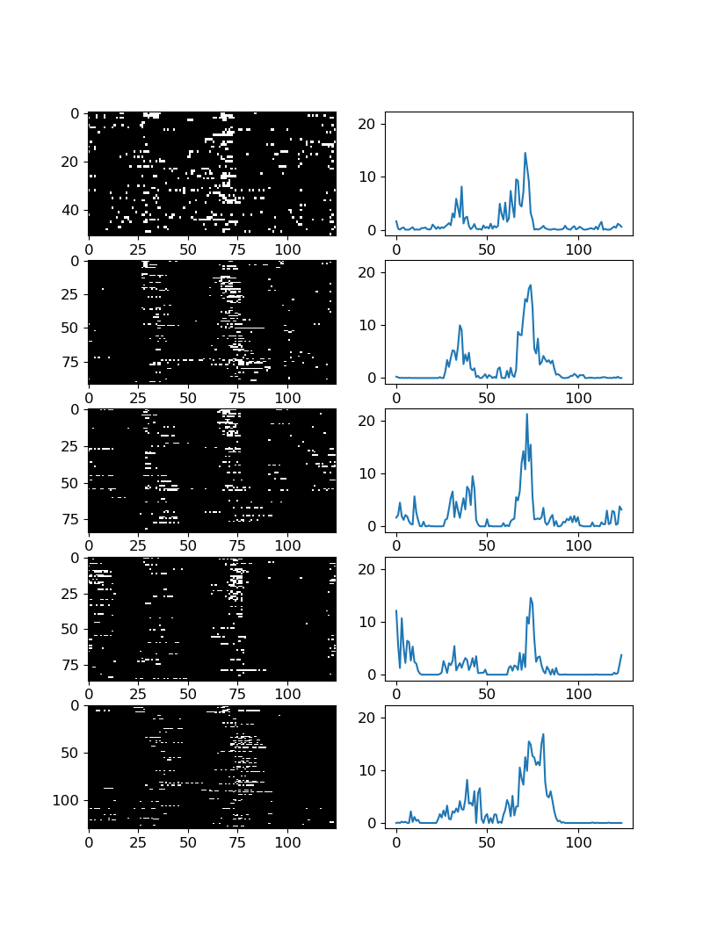
Visualizing classical place fields

Slide 25
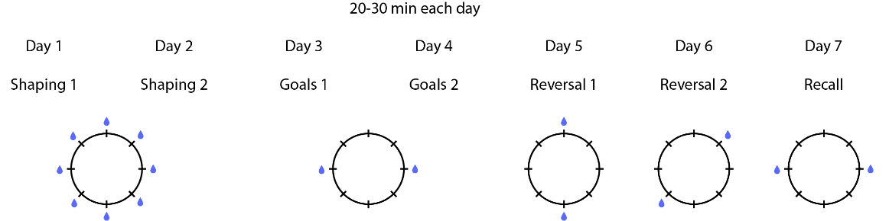
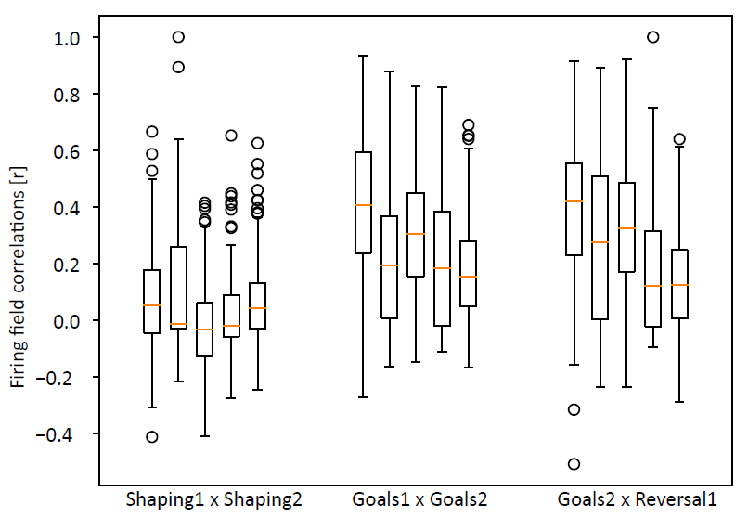
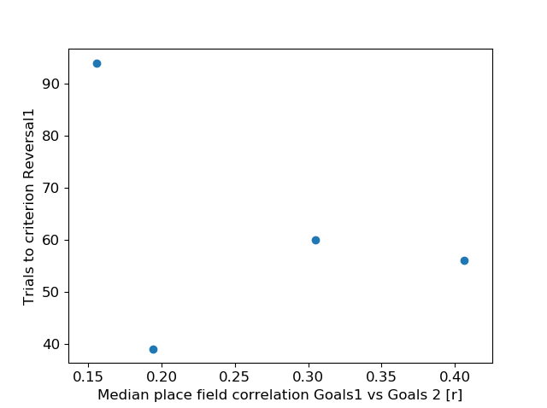
Does stability anti-correlate with flexibility?
Session pair firing field correlations
Correlate fields
Assess performance

Slide 26
How to measure “persistence”?
Firing field correlations
Ensemble reactivations

Slide 27
PCA/ICA procedure for detecting ensembles
Activity (S) is binarized, binned, and normalized.
Determine # of ensembles by comparing PCA eigenvalues to those from shuffled data (independent cell-by-cell circular shifts).
Extract weights of cells towards each ensemble with ICA where # of components = # of ensembles
Estimate ensemble activity (co-activation of highly-weighted cells).

Slide 28
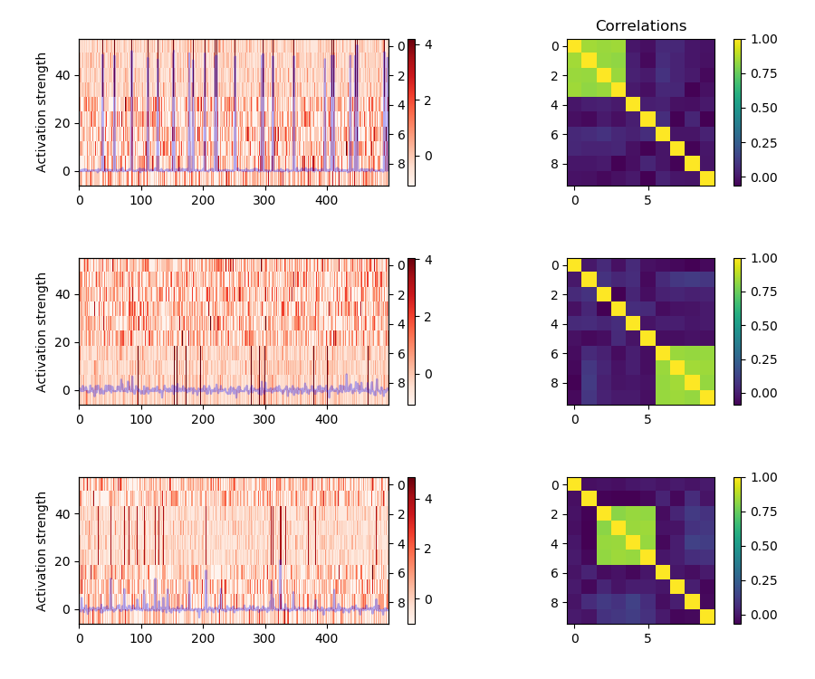
Assembly detection using PCA/ICA

Slide 29
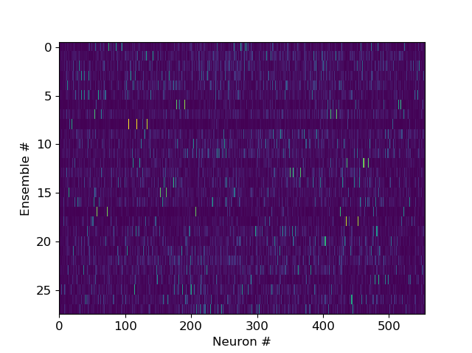
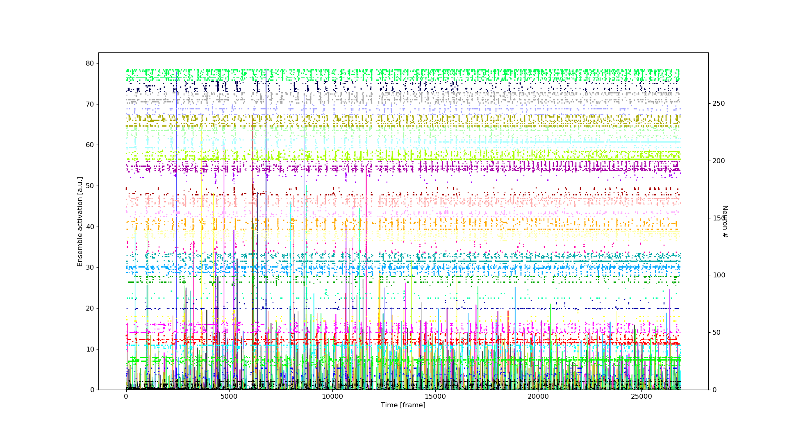
PCA/ICA outputs on real data (Castor, Goals2)

Slide 30
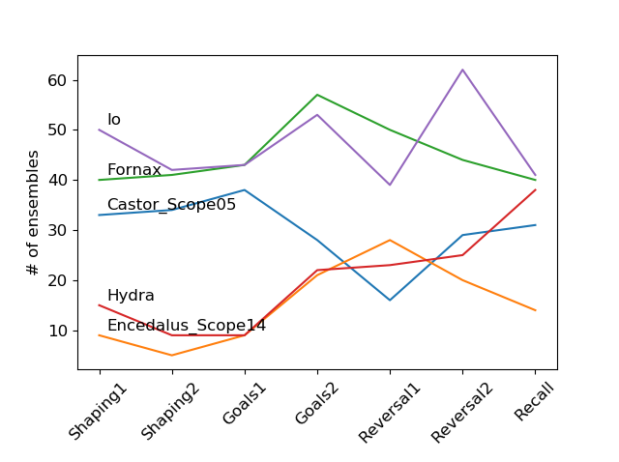
# of ensembles mostly constant across sessions

Slide 31
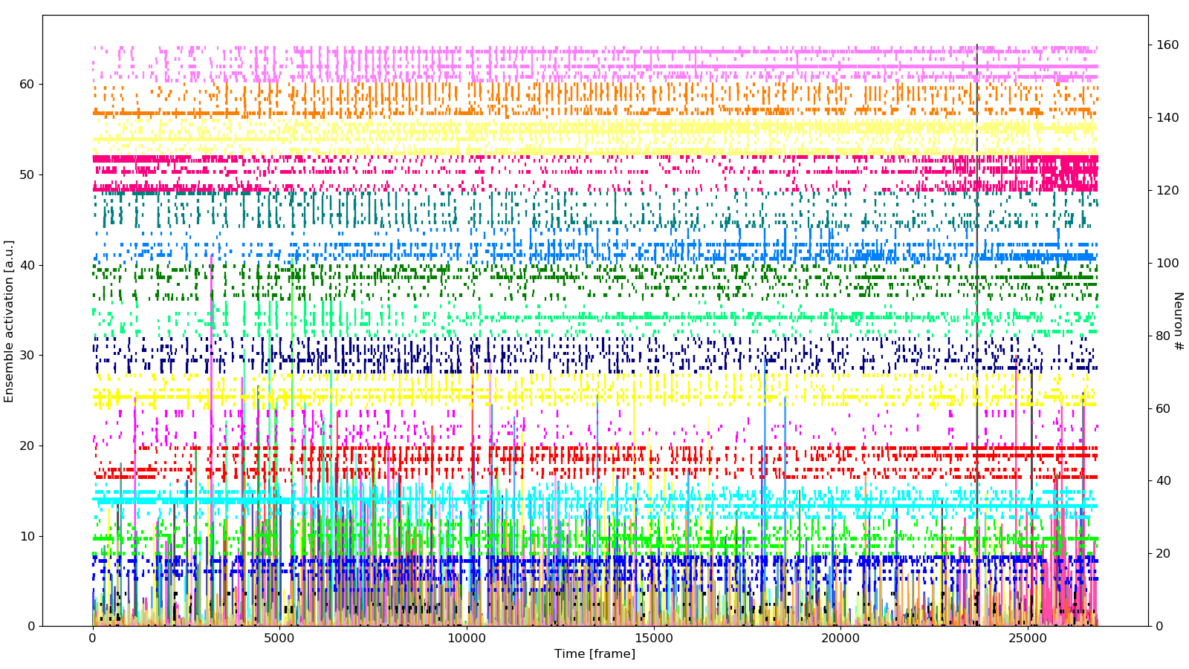
Comparing ensemble activations in Reversal vs. Goals sessions
Goals2
Reversal1

Slide 32
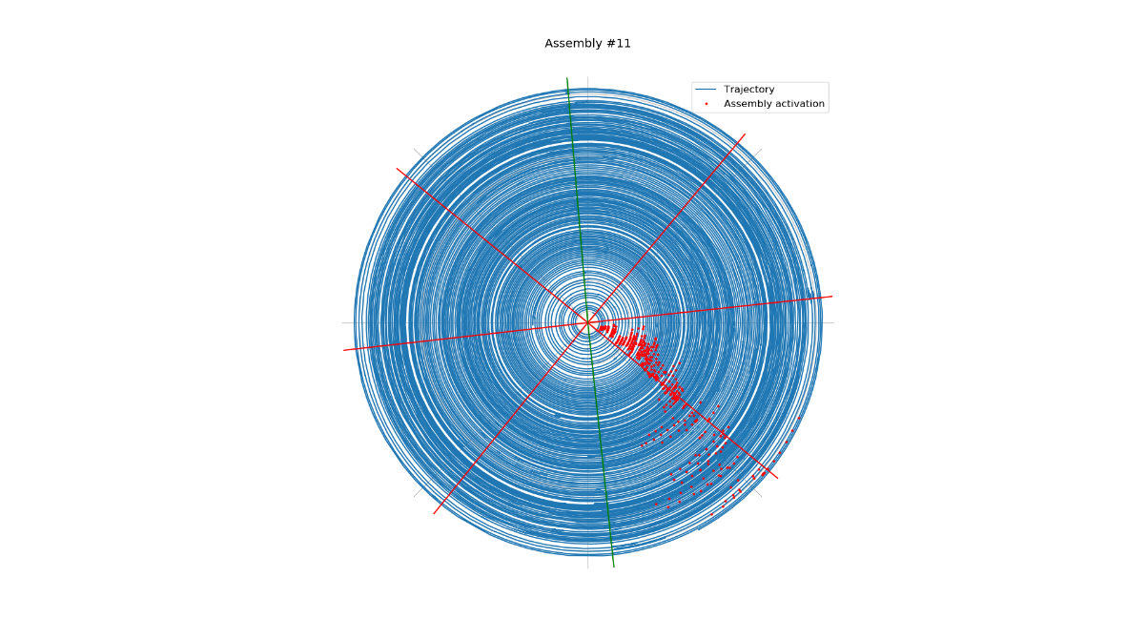
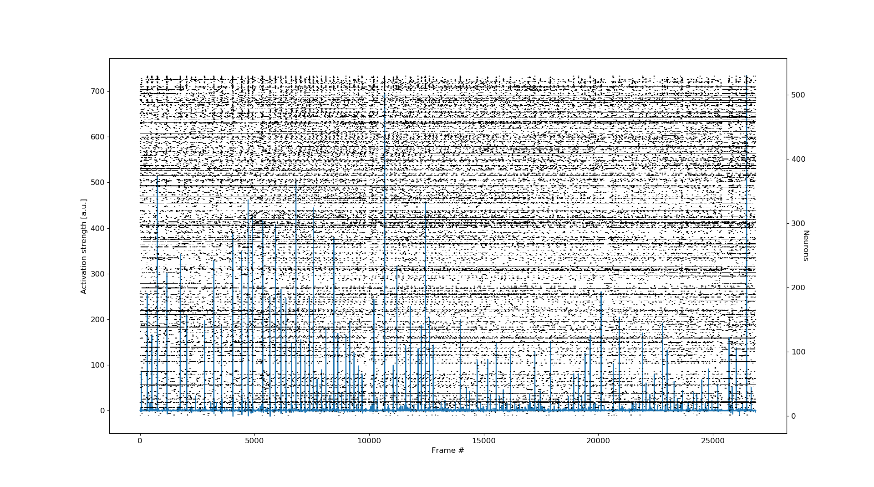
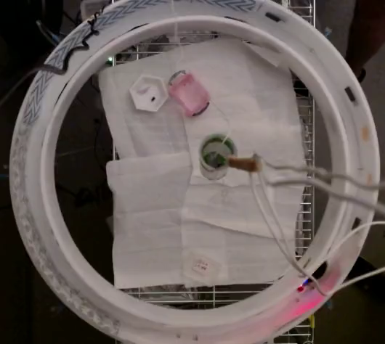
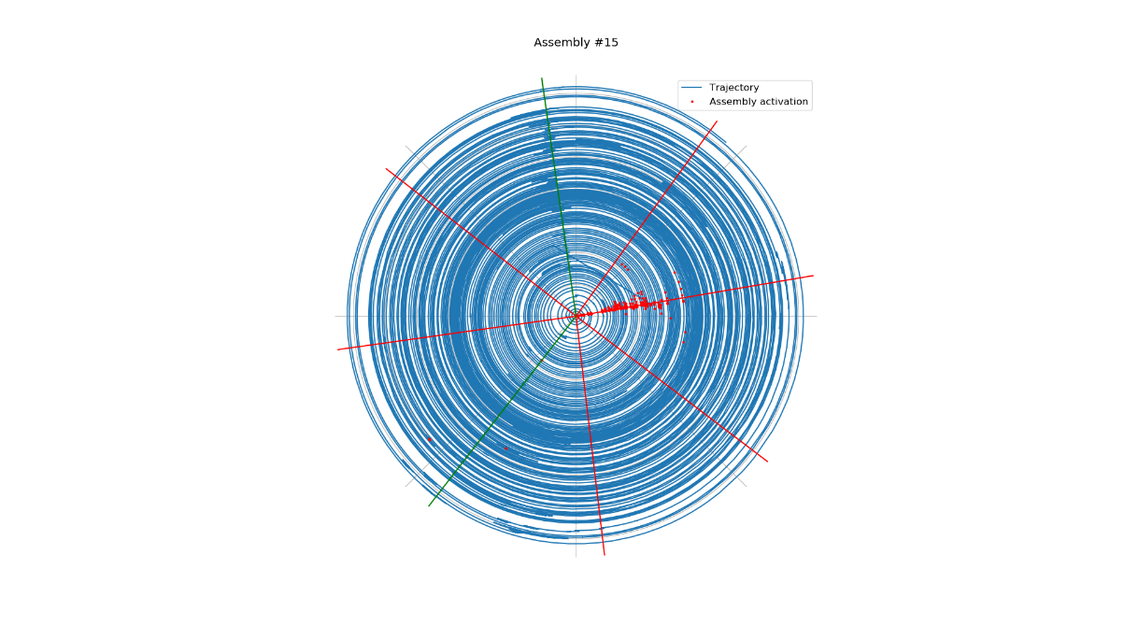
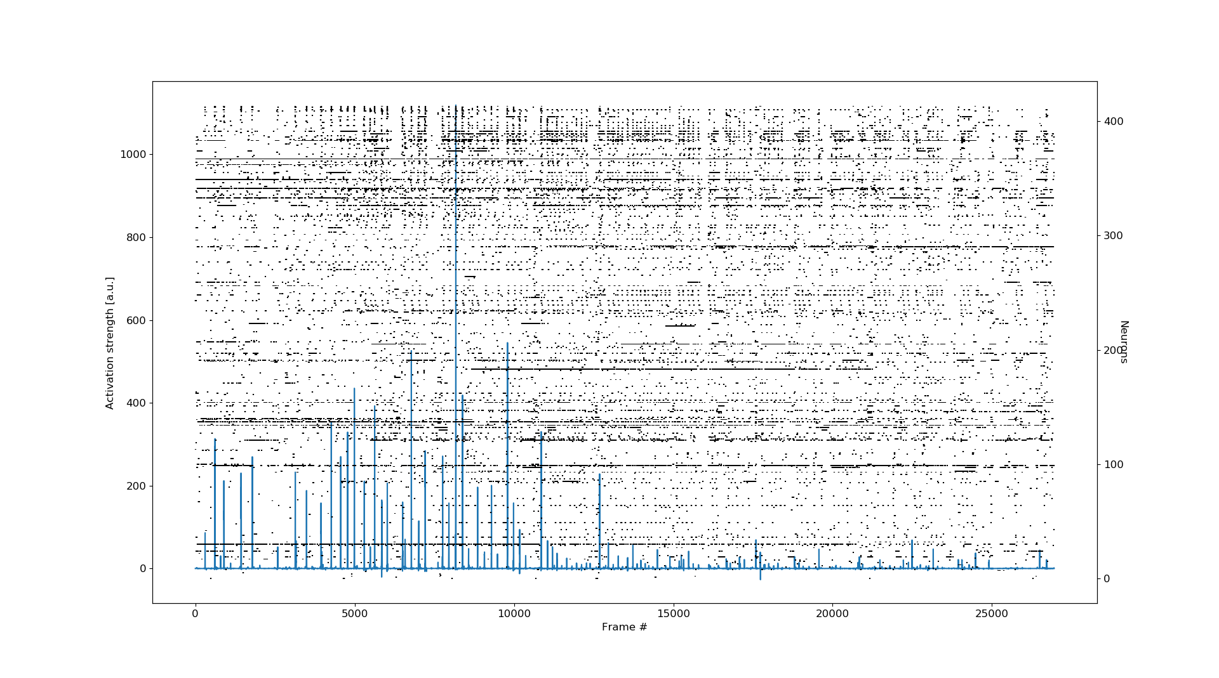
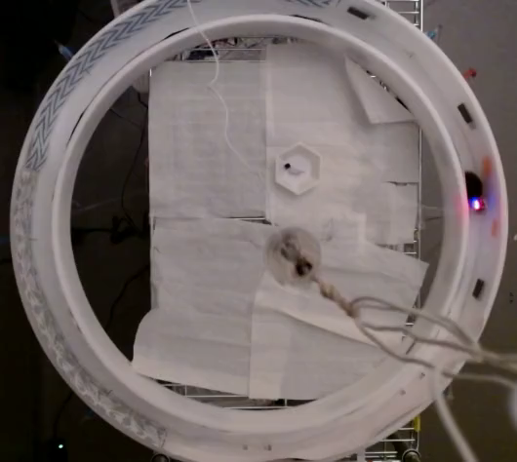
Example ensembles active during perseverative seeking

Slide 33
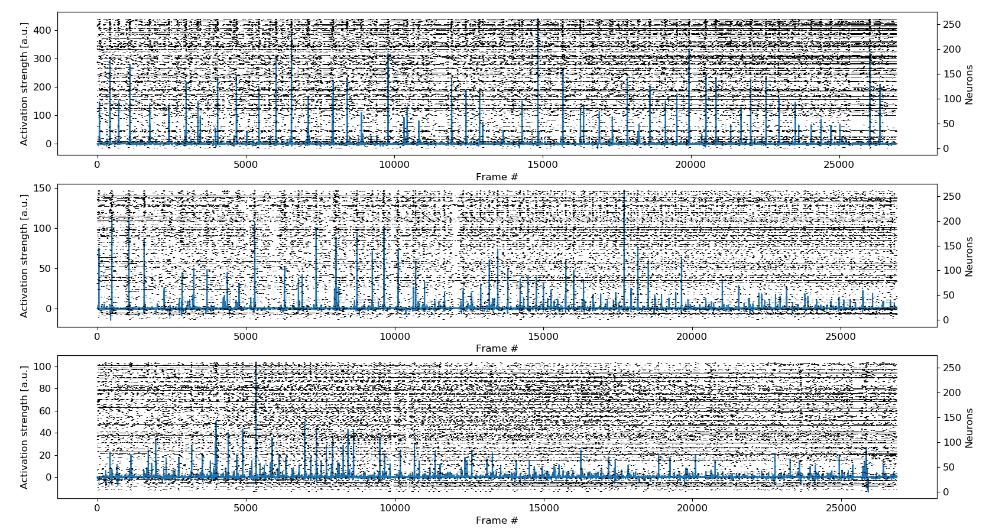
Starting to examine ensembles across days
Goals1
Goals2
Reversal1

Slide 34
To do
More analyses
3 young mice to record from
+3 waiting to be base plated
1 aged mouse to record from
+4 waiting to be base plated
dCA1 inhibition with PSAM during Reversal1
Neurogenesis/LTD knockdown

